Slide 1
POPLITEAL FOSSA
BY
DR OJEWALE A.O

Slide 2
OUTLINES
Introduction
Boundaries
Contents
Popliteal artery and its variations
Popliteal lymph nodes
Applied Anatomy

Slide 3
Intro’
It is a diamond-shaped hollow located behind the knee joint
It is bounded by the diverging tendons of the hamstrings above and the converging heads of gastrocnemius below.
It is shallow when the knee is extended but deep when it is flexed (becomes prominent) [because the tendons of the hamstrings stand out].

Slide 4
Cont’d
It is an important anatomical region because it provides passage for main vessels and nerves from the thigh to the leg.
It has four borders (superomedial, superolateral, inferomedial and inferolateral), a floor and a roof.
It contains the popliteal vessels, parts of the tibial, common peroneal, and posterior femoral cutaneous nerves, small saphenous vein, lymph nodes and adipose tissue.

Slide 5
Boundaries of Popliteal fossa
The superomedial border is formed by semitendinosus and semimembranosus.
The superolateral border is formed by biceps femoris.
The inferomedial border is formed by the medial head of gastrocnemius.
The inferolateral border is formed by the lateral head of gastrocnemius and plantaris.
The floor is formed, from above downwards, by the popliteal surface of femur, oblique popliteal ligament of the knee joint, and the fascia which covers popliteus muscle.

Slide 6
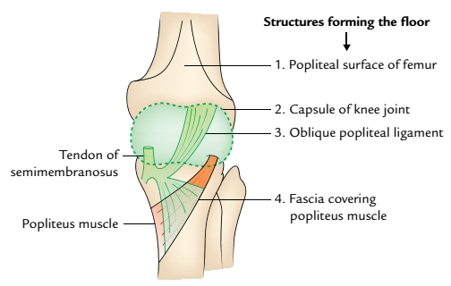
Floor of the popliteal fossa (surface view).

Slide 7
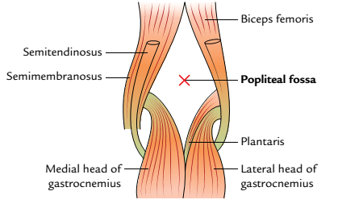
Cont’d
The roof is formed by the popliteal fascia (the deep fascia which overlies the popliteal fossa).
Boundaries of the popliteal fossa

Slide 8
Contents of Popliteal fossa
In the popliteal fossa, note that
Tibial nerve is the larger terminal branch of the sciatic nerve. It extends vertically downward from the superior angle to the inferior angle of the popliteal fossa. It crosses popliteal artery superficially from the lateral to medial side with popliteal vein intervening between the artery and nerve.
The tibial nerve descends from the upper to the lower angles of the fossa, thereby bisecting it; it is located superficial (posterior) to the popliteal vessels.

Slide 9
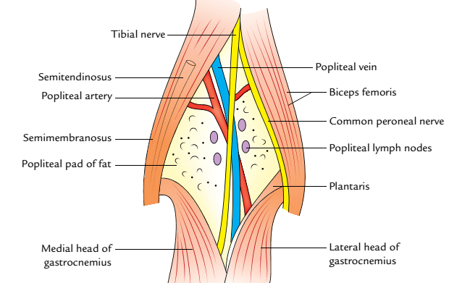
Boundaries and contents of the popliteal fossa

Slide 10
Cont’d
The common peroneal nerve passes inferolaterally, along the medial border of the tendon of biceps femoris; it leaves the fossa at its lateral angle, superficial to the lateral head of gastrocnemius.
The popliteal artery is the deepest structure in the popliteal fossa, it enters the fossa through the adductor hiatus and terminates at the lower border of popliteus (by dividing into anterior and posterior tibial arteries).

Slide 11
Cont’d
The popliteal vein ascends behind (superficial to) the popliteal artery; it leaves the fossa through the adductor hiatus.
The popliteal lymph nodes are located around the popliteal vessels; they drain part of the lower limb.
Popliteal pad of fat.

Slide 12
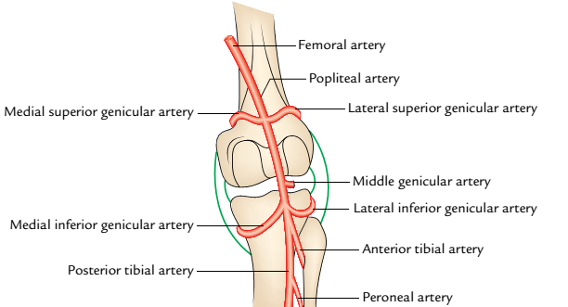
genicular branches of the popliteal artery

Slide 13
In the popliteal fossa, the tibial nerve
Gives rise to the sural nerve; this innervates the skin of the lateral aspect of the leg and foot.
Gives motor fibres (muscular branches) to popliteus, plantaris, soleus and gastrocnemius.
Gives three articular branches to the knee joint and it enters the leg deep to soleus and gastrocnemius.
Is represented by a vertical line drawn from the apex of popliteal fossa above, to the level of the neck of fibula below.

Slide 14
Regarding the branches of tibial nerve, note that
The sural nerve leaves the popliteal fossa by descending between the two heads of gastrocnemius; this nerve pierces the deep fascia in the proximal part of the leg.
A peroneal communicating nerve (a branch of common peroneal nerve) joins the sural nerve in the leg.
The nerve to soleus enters this muscle through it superficial surface.
The nerve to popliteus initially descends superficial to the popliteus; it then curves round its lower border to enter the muscle through its deep surface.

Slide 15
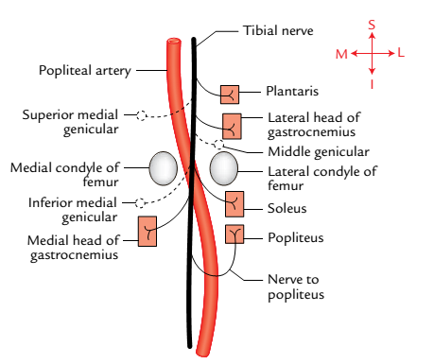
Branches of the tibial nerve in the popliteal
fossa

Slide 16
Cont’d
The three articular branches of the tibial nerve accompany the superior medial, middle, and inferior medial genicular arteries, to innervate the knee joint.

Slide 17
In the popliteal fossa, the common peroneal nerve
Passes inferomedially along the medial border of the tendon of biceps femoris; it leaves the fossa, superficial to the lateral head of gastrocnemius, to enter the leg.
Is represented by an oblique line which extends from the apex of popliteal fossa above, to the head of fibula below, just medial to biceps femoris tendon up to the lateral angle of the fossa.
Here it crosses superficial to the plantaris, lateral head of gastrocnemius to reach the back of the head of fibula.

Slide 18
Cont’d
Finally, it winds around the posterolateral aspect of the neck of fibula, pierces the peroneus longus muscle, and terminates by dividing into deep and superficial peroneal nerves.

Slide 19
Cont’d
Gives rise to the lateral cutaneous nerve of the calf (lateral sural nerve) ; this innervates the skin on the upper part of the lateral side of the leg.
Sural communicating nerve: It arises opposite to the head of the fibula, and crosses superficially to the lateral head of gastrocnemius to join the sural nerve.
Also gives rise to three articular branches which include the superior lateral genicular, inferior lateral genicular, and recurrent genicular nerves. The first two supply the knee joint and the last one supplies the superior tibiofibular joint.

Slide 20
POPLITEAL ARTERY
Is the direct continuation of the femoral artery as this traverses the adductor hiatus to enter the popliteal fossa (from the adductor canal).
Inclines inferolaterally as it traverses the popliteal fossa; thus it
Descends initially anteromedial, then anterior and finally anterolateral to the popliteal vein.
Is closely bound to the popliteal vein by fibrous tissue.
Supplies the knee joint , contents of the popliteal fossa and adjacent muscles.

Slide 21
BRANCHES OF POPLITEAL ARTERY
The popliteal artery gives rise to
Five genicular branches; these include superior medial, superior lateral, inferior medial, inferior lateral, and middle genicular arteries (which supply the knee joint).
Superior muscular branches, which supply the hamstrings and adductor magnus.
Sural arteries, which supply gastrocnemius, soleus, and plantaris.
Cutaneous branches, to the skin of the calf.

Slide 22
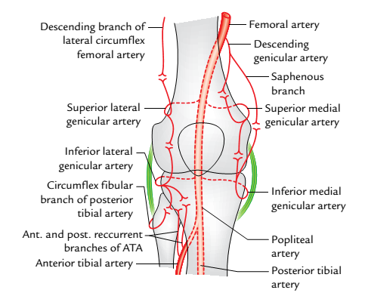
Cont’d
Arterial anastomosis (genicular anastomosis)
around the knee joint (ATA = anterior tibial artery)

Slide 23
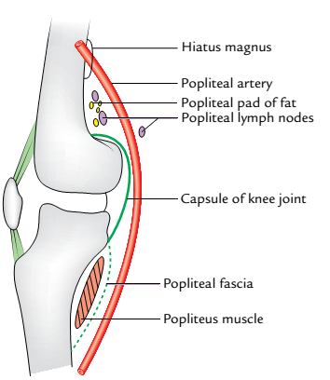
Cont’d
Anterior (deep) relations of the popliteal artery

Slide 24
POPLITEAL ARTERY AND ITS VARIATIONS
In the popliteal fossa, the popliteal artery
May end proximal to popliteus; in this instance, the anterior tibial artery descends anterior to popliteus.
May also end by dividing into anterior tibial and peroneal arteries; in this instance, the posterior tibial artery is absent or small.

Slide 25
POPLITEAL VEIN
The popliteal vein
Is formed at the lower border of popliteus by the union of the anterior and posterior tibial veins.
Initially ascends posteromedial to, then posterior and finally posterolateral to the popliteal artery (in the popliteal fossa).
Is located deep to the tibial nerve, as it ascends in the popliteal fossa.

Slide 26
Cont’d
Leaves the popliteal fossa through the adductor hiatus, to traverse (ascend in) the adductor canal and femoral triangle as the femoral vein.
Receives the small saphenous vein; it also receives tributaries from the knee joint and adjacent muscles.

Slide 27
POPLITEAL LYMPH NODES
The popliteal lymph nodes are about six; they are embedded in the fatty tissue of the popliteal fossa.
The popliteal nodes may be divided into superficial and deep groups.
The superficial popliteal nodes are located in the popliteal fat; one of these usually lies near the termination of the small saphenous vein (the territory of which it drains).

Slide 28
Cont’d
The deep popliteal nodes lie along the popliteal vessels; they drain the deep tissue of the leg and the knee joint. One of these lies between the popliteal artery and the knee joint. It drains the latter.
Remaining nodes are situated on both sides of the popliteal artery.
The popliteal lymph nodes drain:
Back and lateral side of calf of the leg.
Lateral side of heel and foot.

Slide 29
APPLIED AND CLINICAL ANATOMY
Popliteal pulse: the pulse of the popliteal artery is difficult to feel in the popliteal fossa; this is owing to the deep location of the artery.
Popliteal pulse is better felt in the lower part of the fossa when the individual is in the prone position, with the knee flexed.
Fluid may collect (from infections, etc) in the popliteal fossa; such a popliteal abscess compresses the contents of popliteal fossa, thereby causing severe pain.

Slide 30
Cont’d
Popliteal aneurysm: The popliteal artery may become abnormally enlarged and more prone to aneurysm than any other artery in the body. Clinically, popliteal aneurysm presents as a pulsatile midline swelling in the popliteal fossa. This causes pain in the popliteal fossa
Baker’s cyst: It is cystic swelling which occurs in the popliteal fossa due to inflammation of synovial bursa underneath the tendon of semimembranosus or protrusion of synovial membrane of the cavity of knee joint through the fibrous capsule of the joint.

Slide 31
Cont’d
The superior muscular branches of popliteal artery anastomose with the perforating branches of profunda femoris; the latter in turn anastomoses with the inferior gluteal and circumflex femoral arteries (in the cruciate anastomoses).
The communication of the superior muscular branches of popliteal artery (indirectly) with the cruciate anastomoses ensures that blood could still reach the leg when the femoral artery is obstructed.

Slide 32
Cont’d
Injury to the lateral aspect of the heel produces enlargement of popliteal nodes.

Slide 33
THANK YOU ALL, FOR LISTENING.

Slide 34


